Slide 1
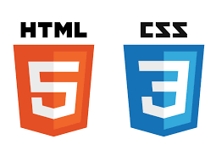
Web Design MCOSS2WED
HTML & CSS refresher

Slide 2
Are we using Brackets?
If we are using Brackets, here’s a short intro.
Otherwise, suggest jsfiddle or a text editor.
Reference material available from:
www.iteachit.net/reference

Slide 3
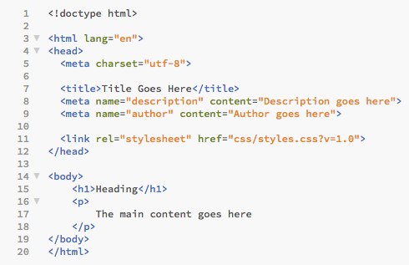
Anatomy of an HTML document
Distribute HTML5 template

Slide 4
Anatomy of an HTML document
Document type (HTML5 format shown)
<html> tells the browser where the HTML code starts
Head (meta data, title, description, links to CSS)
</html> tells the browser where the HTML code ends
Body (main content area)

Slide 5
Anatomy of an HTML document
Most HTML tags need to be closed using a forward slash:
<h1> … </h1>
<ol> … </ol>

Slide 6
Anatomy of an HTML document
…but not all:
<br> Does not take a closing tag
<p> The closing </p> is optional

Slide 7
Anatomy of an HTML document
Headings are created using <h1> … </h1> (up to <h6>).
Paragraphs are created using <p> … </p>.
Show examples 1 to 2.
Task: Select five quotes and put into a new webpage. Include a heading.

Slide 8
Anatomy of an HTML document
HTML ignores white space.
Text can be broken up using tags such as <br>.
Quotations can be signified using <q> and <blockquote>.
Show example 3.
Task: Format the quotations using any method(s) choosing from <q>, <br>, <blockquote>.
Q: Is everything behaving as expected?

Slide 9
Anatomy of an HTML document
Ordered and unordered lists can be created using <ol> and <ul>.
Each list item must be encapsulated with <li> … </li>.
Show example 4.
Task: Format the quotes as an unordered list.

Slide 10
Anatomy of an HTML document
Show example 5.
Task: Change the format of the quotes to an ordered list.

Slide 11
Styling
CSS (Cascading Style Sheets) are used to change the style of the HTML document.
Styling can be:
inline as part of the HTML code or
external as a .css file
Inline takes precedence over external styling.

Slide 12
Styling
Inline styling is formatted like this:
<tagname style = “property:value;”>

Slide 13
Styling
Show example 6 – inline colour styling.
Task: Change the styling of the HTML document using the inline method.
<tagname style = “property:value;”>

Slide 14
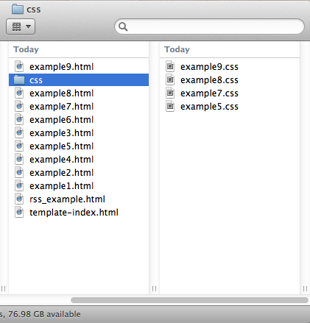
Styling
The preferred styling method is to use an external CSS file. This file (or files) will usually reside in a css directory in the web root.

Slide 15
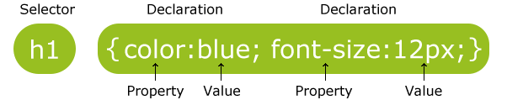
Styling
External CSS formatting is as follows:
Image taken from http://www.w3schools.com/css/css_syntax.asp

Slide 16

Styling
For example, if we wanted to change the style associated with the header tag <h1>, we could add the following to our CSS file:
h1 {
color: orange;
background-color: grey;
font-family: sans-serif;
}
‘color’ here refers to the font colour

Slide 17
Styling
The advantages to using an external CSS file for styling:
You only need to change the style in one place
Easier to read the HTML files

Slide 18
Styling
Show CSS examples 7 through to 9.
Tasks:
1. Remove all inline styling and instead create a CSS file for styling.
2. Try styling: headers, paragraphs, lists, body.
3. Try adding borders to one or more elements.

Slide 19
Styling – extended tasks
Research methods for setting colour in CSS.
Use at least three of these methods in your HTML page.
Which method(s) can specify an alpha attribute?
Which colour method is preferable overall?
What are “web safe” colours? Are they still relevant today?

Slide 20
Styling
<ol> vs <ul>
Show example 10.
The ordered list is now UNORDERED (using <ul>).
Task: Change your list to unordered.

Slide 21
Styling
An unordered list can be used to create navigation.
Show example 11.
A <nav> section with an unordered list has been added.
Tasks:
Add a <nav> section at the top of your page.
Add an unordered list inside the <nav> section (this will be used for navigation later).

Slide 22
Styling
Notice that both <ul> sections are styled the same.
To change this, we can add a class to the unordered list inside <nav>:
<ul class="top-menu">
This can be seen in example 12.

Slide 23
Styling
We can also add classes to the individual links in our list:
<li class="nav-link">Home</li>
This can be seen in example 13 where I’ve added the following to the CSS file to change the way the list has been displayed to inline:
li.nav-link {
display: inline;
}

Slide 24
Styling
Objects can be floated to position them.
I’ve done this for the nav links in example 14 using:
float: right;

Slide 25
Styling
The height of an element can be specified using:
height: 25px;
And padding can be added to an element. Eg:
padding: 3px;
Padding adds a cushion of pixels around an object.
See example 15 for a demonstration of this.

Slide 26
Styling
To turn our list into links, we simply add anchor tags:
<li class="nav-link"><a href=”[Link]">Link text</a></li>
Eg:
<a href=“www.google.com”>Search the web</a>
See example 16.

Slide 27
Styling
Links can be styled – as can the different states of the link (hover, visited, natural).
See example 17.

Slide 28
Styling
To make the transitions smoother, we can style them as well.
See example 18.

Slide 29
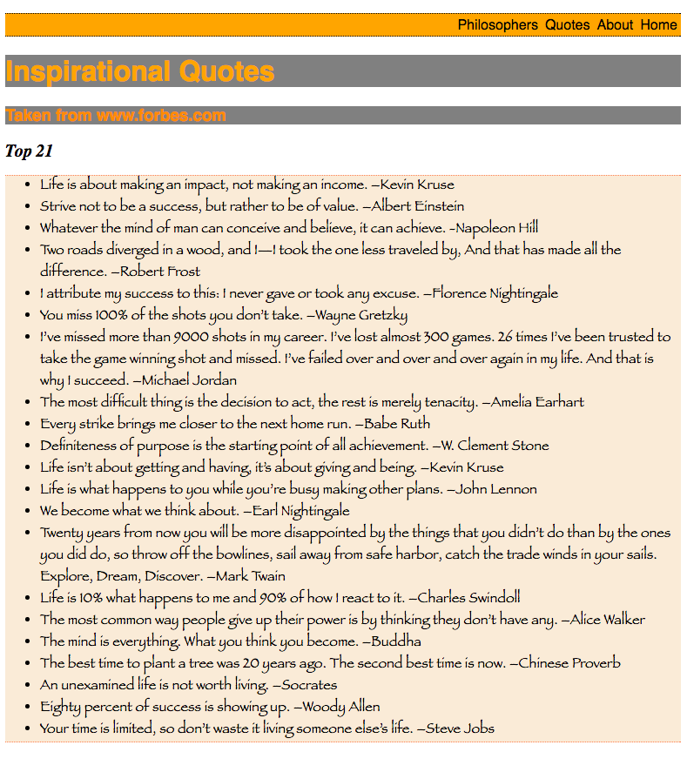
Styling
This is my web page so far:

Slide 30
Styling
We have not paid much attention to actual design: we have concentrated on code. But with a bit of thought and a few CSS changes, it could look a lot better.

Slide 31
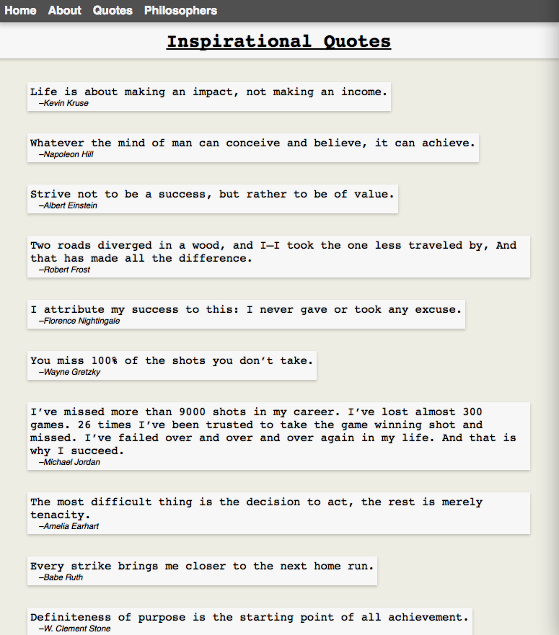
Styling
Using the same content and just changing the CSS can dramatically change your webpage.
Show Md-example

Slide 32
Styling – extended tasks 3
Find out what Google Material Design is.
What aspects of Material Design are important to its overall aim?
Find three websites that use Material Design.
How well have these sites implemented Material Design?

Slide 33
Styling – Material Design
Material Design is a design concept envisaged by Google to create a standard user experience throughout their phone and app range. The design concepts can be equally applied to web design.

Slide 34
Styling – Material Design
The concept relies on a three dimensional application space populated by cards of information. The cards (material) are designed to mimic physical cards to a large degree. This is done by making sure that material does not travel through each other and by positioning in 3D space using shadows.

Slide 35
Styling – Material Design Example
We can go some way to mimicking Material Design by creating content in the form of “cards” delimited by margins and padding and by using simple CSS techniques such as box-shadow.

Slide 36
Styling – Material Design Example
Create a body style in your CSS file.
Eg:
body {
background-color: rgb(237,237,227);
margin: 0;
}

Slide 37
Styling – Material Design Example
If we use <blockquote> tags in our HTML for all our quotations, we can section off our quotations onto individual cards.
<blockquote>Life is about making an impact, not making an income.<footer> –Kevin Kruse</footer></blockquote>

Slide 38
Styling – Material Design Example
We can style the <blockquote> tags to add colour and padding to distinguish them from the body in CSS:
blockquote {
background-color: rgb(247,247,247);
display: inline-block;
padding: 4px;
}

Slide 39
Styling – Material Design Example
To my blockquote CSS I have added a font and font size. I have also added a subtle box-shadow:
blockquote {
font-family: monospace;
font-size: 1.2em;
background-color: rgb(247,247,247);
box-shadow: 0px 2px 5px rgba(0,0,0,0.2);
display: inline-block;
padding: 4px;
}

Slide 40
Styling – Material Design Example
The result so far looks something like this:

Slide 41
Styling – extended task 5
Using new HTML and CSS files, create a Material Design style webpage using your quotations content.
You may wish to sketch a design on paper first

Slide 42
Styling – extended task 4
For some of the CSS examples, I have used “em” to specify font size.
Eg:
blockquote {
font-family: monospace;
font-size: 1.2em;
}
Find out what an “em” is and why it is sometimes preferred to “px” units in web design.

